Slide 1

PROJECT ENGINEERING AND MANAGEMENT
Course Code: CH62028
Dr. SUVERNA TRIVEDI
Assistant Professor
Department of Chemical Engineering, IIT KGP
Email: strivedi@che.iitkgp.ac.in

Slide 2
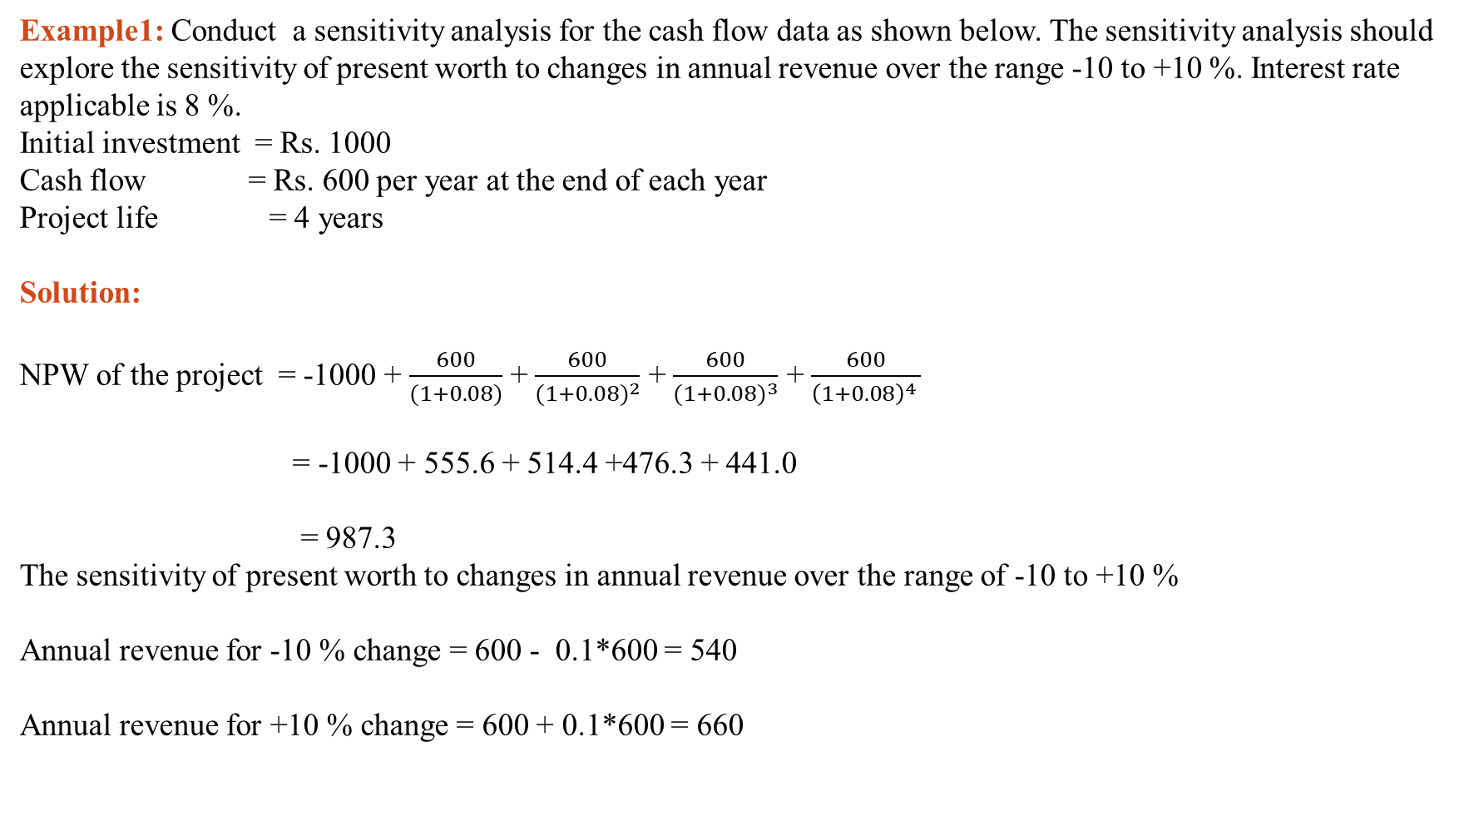
Sensitivity Analysis
Example1: Conduct a sensitivity analysis for the cash flow data as shown below. The sensitivity analysis should explore the sensitivity of present worth to changes in annual revenue over the range -10 to +10 %. Interest rate applicable is 8 %.
Initial investment = Rs. 1000
Cash flow = Rs. 600 per year at the end of each year
Project life = 4 years
Solution:
NPW of the project = -1000 + $\frac{600}{(1+0.08)}$ + $\frac{600}{{(1+0.08)}^{2}}$ + $\frac{600}{{(1+0.08)}^{3}}$ + $\frac{600}{{\left(1+0.08\right)}^{4} }$
= -1000 + 555.6 + 514.4 +476.3 + 441.0
= 987.3
The sensitivity of present worth to changes in annual revenue over the range of -10 to +10 %
Annual revenue for -10 % change = 600 - 0.1*600 = 540
Annual revenue for +10 % change = 600 + 0.1*600 = 660

Slide 3
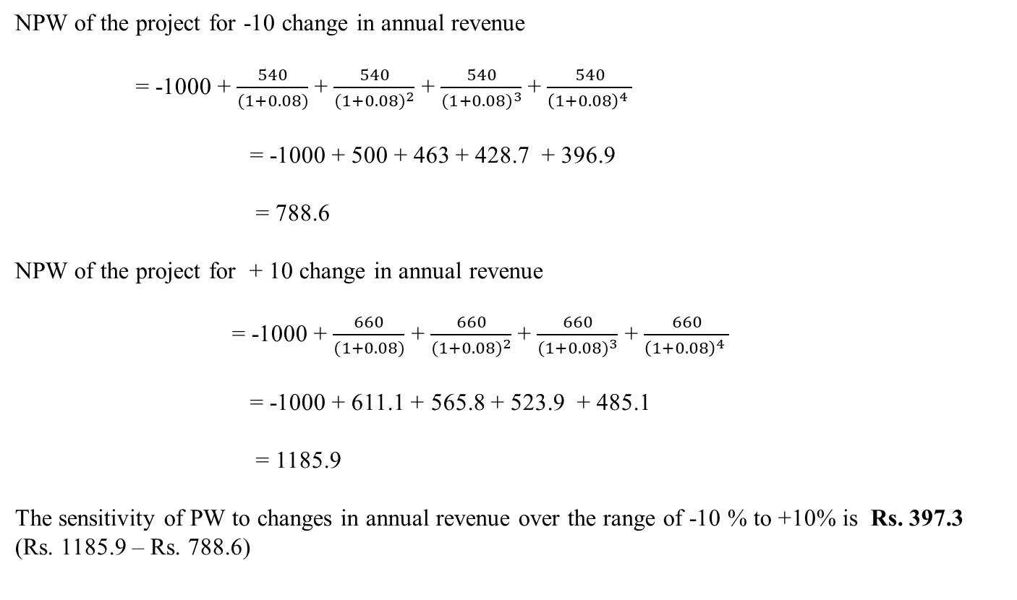
NPW of the project for -10 change in annual revenue
= -1000 + $\frac{540}{(1+0.08)}$ + $\frac{540}{{(1+0.08)}^{2}}$ + $\frac{540}{{(1+0.08)}^{3}}$ + $\frac{540}{{\left(1+0.08\right)}^{4} }$
= -1000 + 500 + 463 + 428.7 + 396.9
= 788.6
NPW of the project for + 10 change in annual revenue
= -1000 + $\frac{660}{(1+0.08)}$ + $\frac{660}{{(1+0.08)}^{2}}$ + $\frac{660}{{(1+0.08)}^{3}}$ + $\frac{660}{{\left(1+0.08\right)}^{4} }$
= -1000 + 611.1 + 565.8 + 523.9 + 485.1
= 1185.9
The sensitivity of PW to changes in annual revenue over the range of -10 % to +10% is Rs. 397.3 (Rs. 1185.9 – Rs. 788.6)

Slide 4
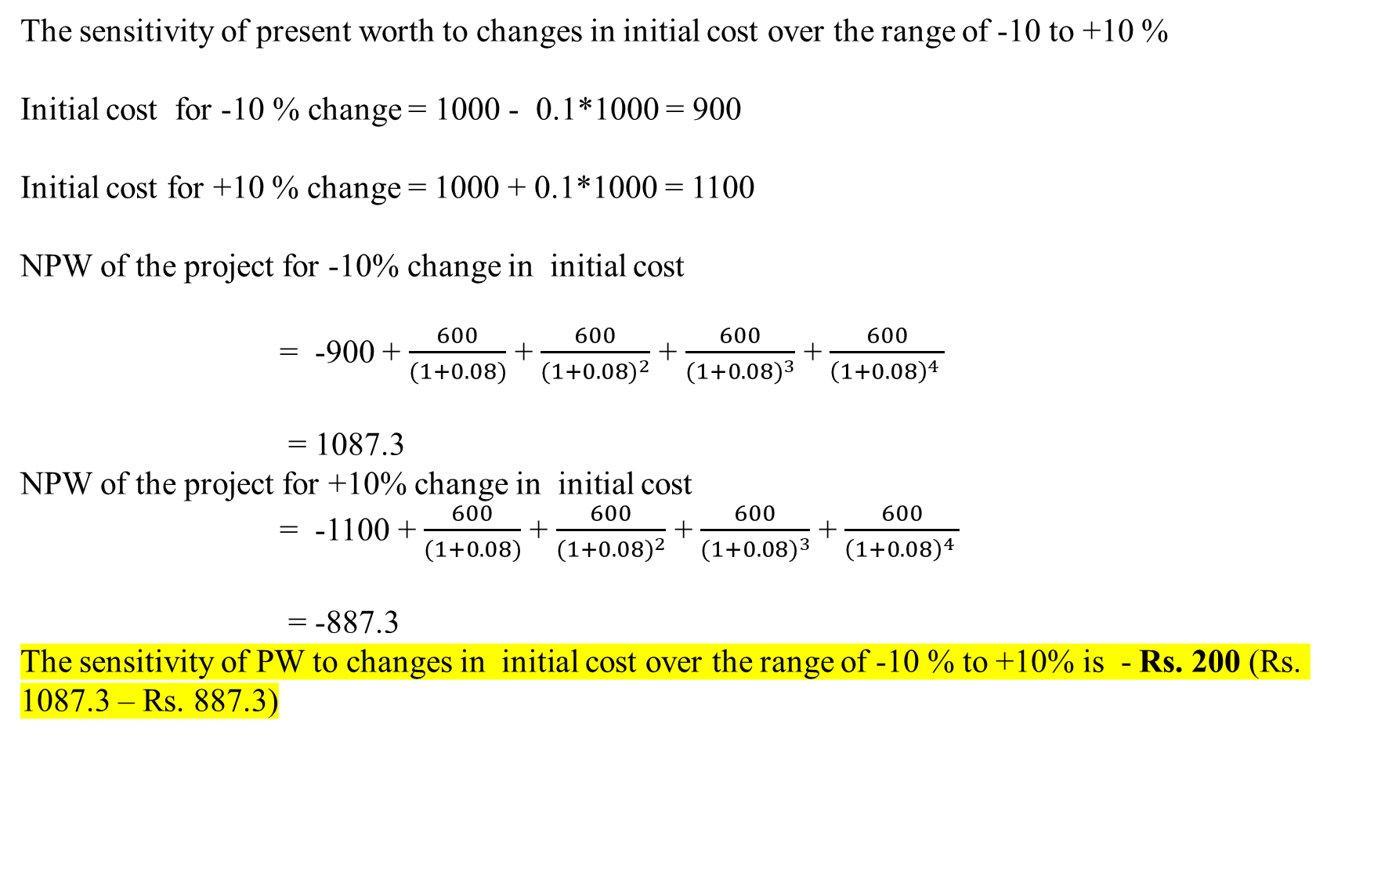
The sensitivity of present worth to changes in initial cost over the range of -10 to +10 %
Initial cost for -10 % change = 1000 - 0.1*1000 = 900
Initial cost for +10 % change = 1000 + 0.1*1000 = 1100
NPW of the project for -10% change in initial cost
= -900 + $\frac{600}{(1+0.08)}$ + $\frac{600}{{(1+0.08)}^{2}}$ + $\frac{600}{{(1+0.08)}^{3}}$ + $\frac{600}{{\left(1+0.08\right)}^{4} }$
= 1087.3
NPW of the project for +10% change in initial cost
= -1100 + $\frac{600}{(1+0.08)}$ + $\frac{600}{{(1+0.08)}^{2}}$ + $\frac{600}{{(1+0.08)}^{3}}$ + $\frac{600}{{\left(1+0.08\right)}^{4} }$
= -887.3
The sensitivity of PW to changes in initial cost over the range of -10 % to +10% is - Rs. 200 (Rs. 1087.3 – Rs. 887.3)

Slide 5
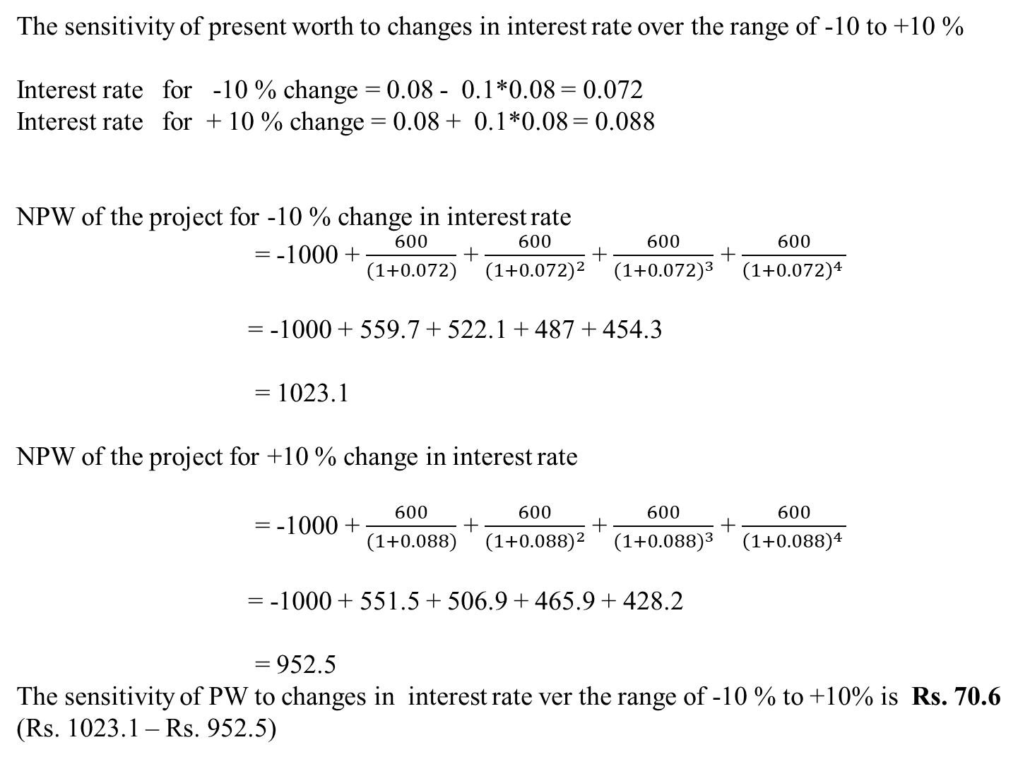
The sensitivity of present worth to changes in interest rate over the range of -10 to +10 %
Interest rate for -10 % change = 0.08 - 0.1*0.08 = 0.072
Interest rate for + 10 % change = 0.08 + 0.1*0.08 = 0.088
NPW of the project for -10 % change in interest rate
= -1000 + $\frac{600}{(1+0.072)}$ + $\frac{600}{{(1+0.072)}^{2}}$ + $\frac{600}{{(1+0.072)}^{3}}$ + $\frac{600}{{\left(1+0.072\right)}^{4} }$
= -1000 + 559.7 + 522.1 + 487 + 454.3
= 1023.1
NPW of the project for +10 % change in interest rate
= -1000 + $\frac{600}{(1+0.088)}$ + $\frac{600}{{(1+0.088)}^{2}}$ + $\frac{600}{{(1+0.088)}^{3}}$ + $\frac{600}{{\left(1+0.088\right)}^{4} }$
= -1000 + 551.5 + 506.9 + 465.9 + 428.2
= 952.5
The sensitivity of PW to changes in interest rate ver the range of -10 % to +10% is Rs. 70.6 (Rs. 1023.1 – Rs. 952.5)

Slide 6
